Slide 1
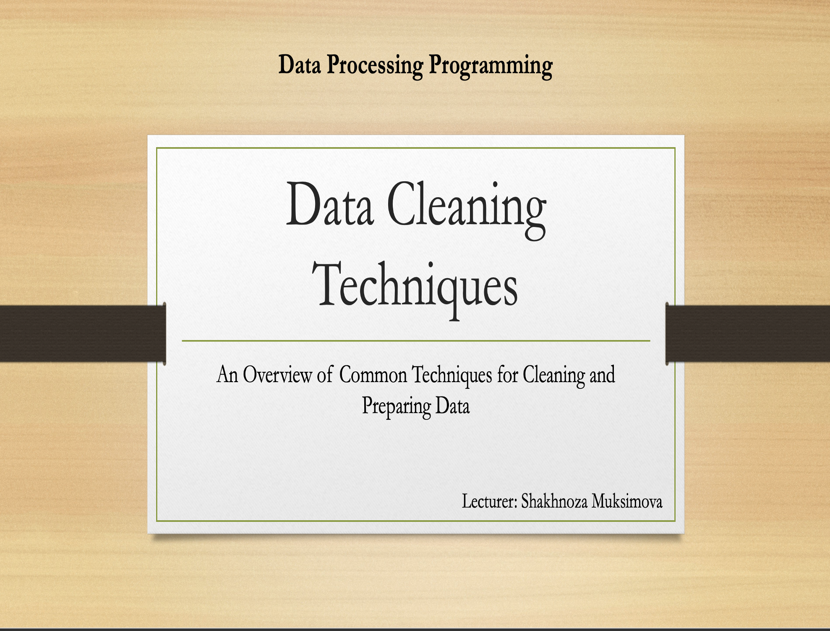

Slide 2
Agenda
Handling missing data
Data normalization
Data transformation

Slide 3

What is Data Cleaning?
Data cleaning is therefore the process of detecting and rectifying faults or inconsistencies in dataset by scrapping or modifying them to fit the definition of quality data for analysis. It is an essential activity in data preprocessing as it determines how the data will be used and processed in other modeling processes.

Slide 4
Importance of Data Cleaning
Improved data quality:
It is therefore very important to clean the data as this reduces the chances of errors, inconsistencies and missing values, which ultimately makes the data to be more accurate and reliable in the analysis.
Better decision-making:
Consistent and clean data gives organization insight into comprehensive and actual information and minimizes the way such organizations make decisions on outdated and incomplete data.
Increased efficiency:
High quality data is efficient to analyze, model or report on it, whereas clean data often avoids a lot of foreseen time and effort that goes into handling poor data quality.
Compliance and regulatory requirements:
There are standard policies the industries and various regulatory authorities set on data quality, and by data cleaning, one can be able to conform with these standards to avoid penalties and legal endangers.

Slide 5
Common Issues in Data
When working with data, several common issues can arise that may impact the quality, analysis, and usability of the data. Understanding these issues is crucial for effectively managing and analyzing data.

Slide 6
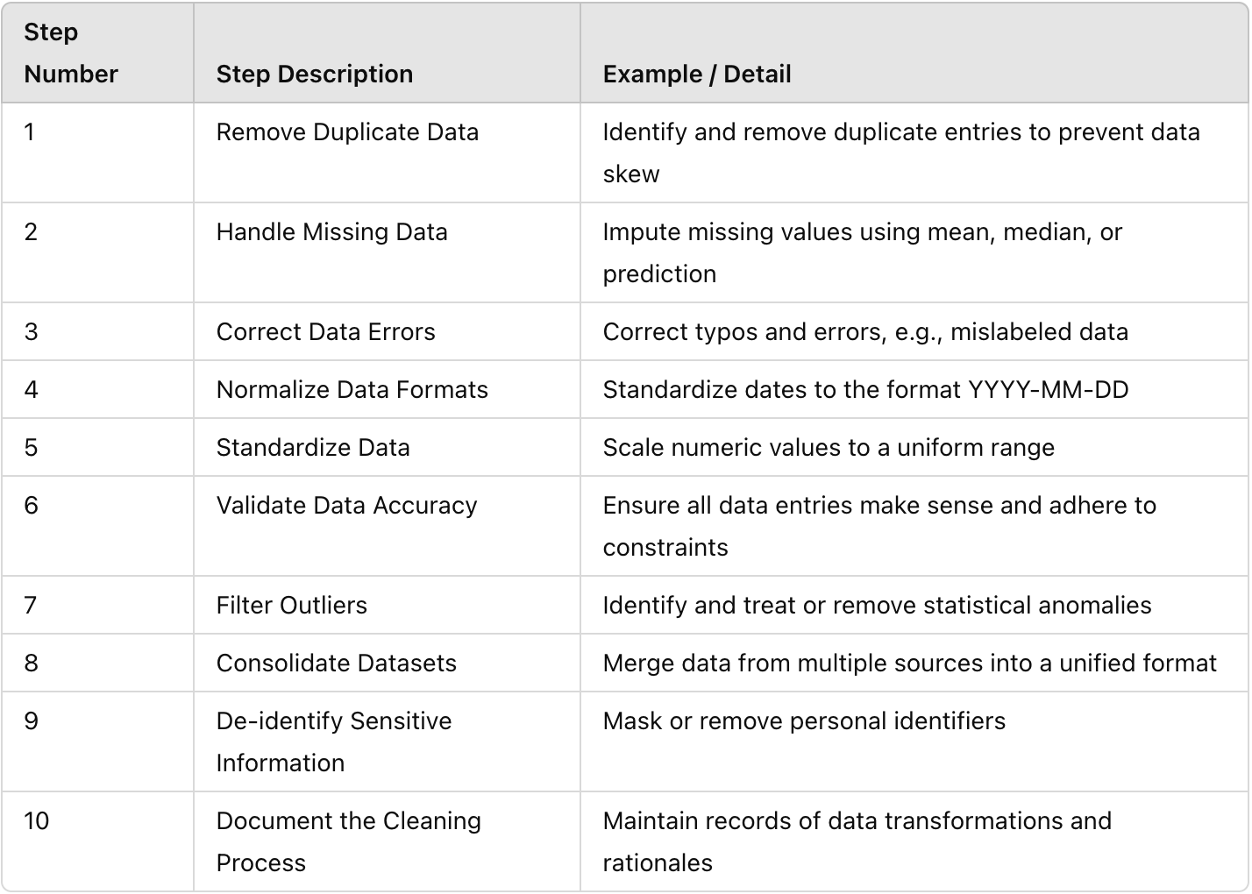
Steps in Data Cleaning

Slide 7
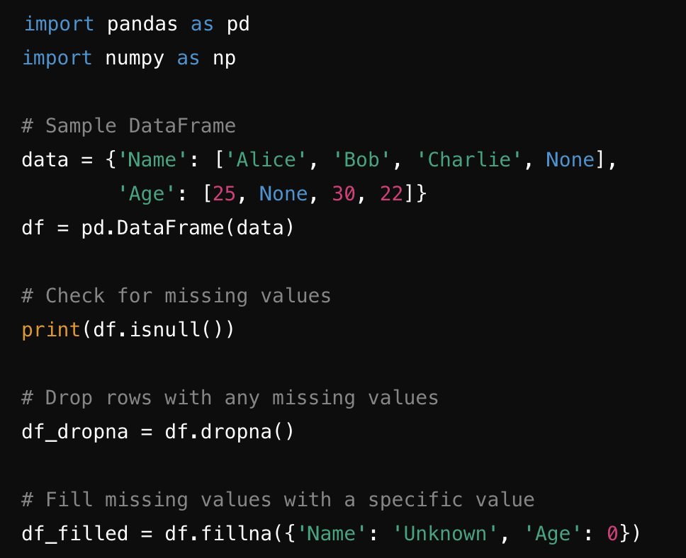
Missing Data
In a dataset of patient records, some entries might be missing values for blood pressure or age. This can occur due to non-response, errors in data collection, or during data transfer.

Slide 8
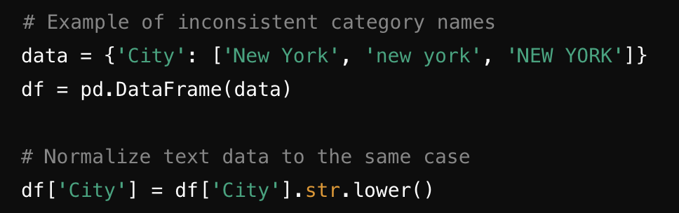
Inconsistent Data
Example: If you collect data from different sources, names of the same item might be recorded differently. For instance, "New York City," "NYC," and "New York, NY" could all refer to the same place but appear differently in the dataset.

Slide 9
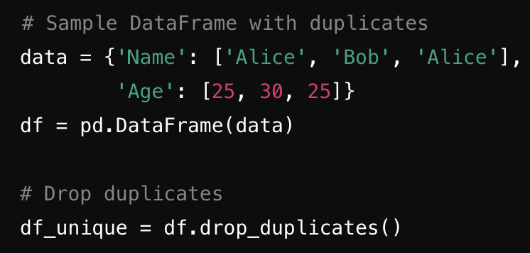
Duplicate Data
Example: In a customer database, the same customer might be entered multiple times with slight variations in their name or address, leading to redundant entries that can skew analysis results.

Slide 10
Outliers
In a dataset of employee salaries, an entry might mistakenly record a salary of $1 million due to a typo or an error in data entry, which is significantly higher than the rest of the data.
# Detecting outliers using standard deviation
data = {'Salary': [50000, 55000, 52000, 47000, 1000000]}
df = pd.DataFrame(data)
# Assuming salary follows a normal distribution, outliers might be beyond 3 standard deviations
mean_salary = df['Salary'].mean()
std_salary = df['Salary'].std()
outliers = df[(df['Salary'] > mean_salary + 3 * std_salary) | (df['Salary'] < mean_salary - 3 * std_salary)]
# Removing outliers
df_no_outliers = df[(df['Salary'] <= mean_salary + 3 * std_salary) & (df['Salary'] >= mean_salary - 3 * std_salary)]

Slide 11
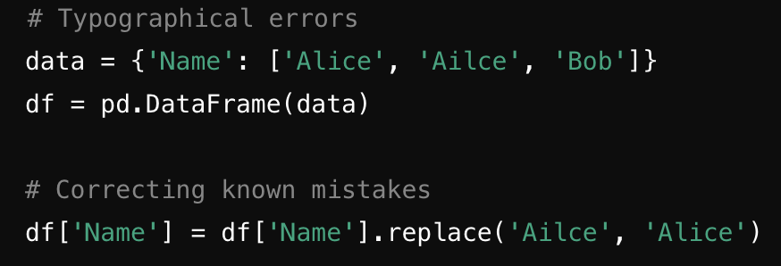
Data Quality Improvements
Data might have typographical errors, such as a customer's name "Jhon" instead of "John", or there may be inaccuracies in details like product specifications.

Slide 12
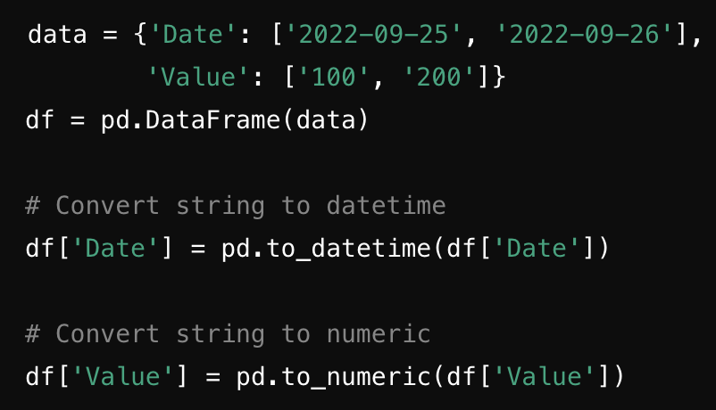
Converting Data Types
When merging data from different systems, mismatches like different currencies or formats (e.g., US dollars vs. Euros, or MM/DD/YYYY vs. DD/MM/YYYY date formats) can lead to inconsistencies.

Slide 13
Preprocessing Techniques
Data cleaning
Noise, outliers, missing values, duplicate data
Dealing with categorical data
Data integration
Data transformation
Data reduction
Sampling
Imputation
Discretization
Feature extraction
Splitting the dataset into training and testing sets
Scaling the features

Slide 14
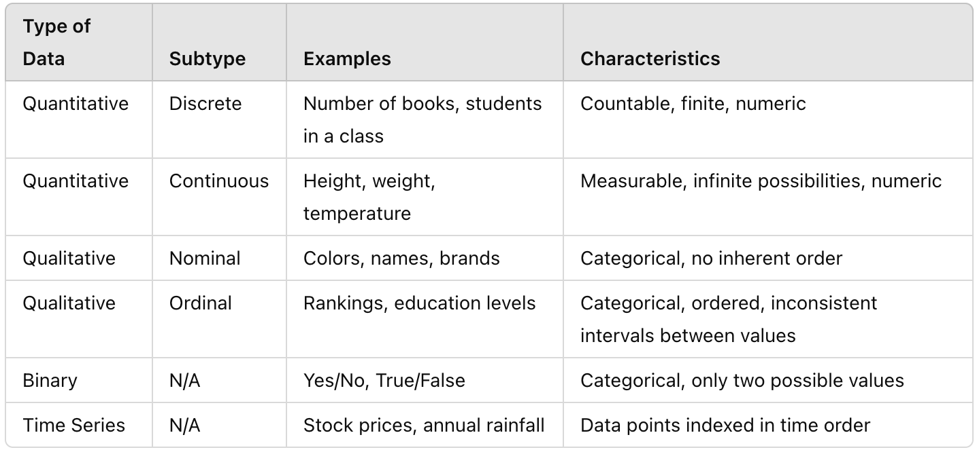
Types of data

Slide 15
quality of data
1. Accuracy
Human/computer errors
Incorrect formats
2. Completeness
3. Consistency
Data preprocessing is divided into four stages
Data cleaning,
Data integration,
Data reduction, and
Data transformation.

Slide 16
Noisy Data
Noise: random error or variance in a measured variable
Incorrect attribute values may be due to
faulty data collection instruments
data entry problems
data transmission problems
technology limitation
inconsistency in naming convention
Other data problems which require data cleaning
duplicate records
incomplete data
inconsistent data
16
Notes:
16

Slide 17
How to Handle Noisy Data?
Binning
first sort data and partition into (equal-frequency) bins
then one can smooth by bin means, smooth by bin median, smooth by bin boundaries, etc.
Regression
smooth by fitting the data into regression functions
Clustering
detect and remove outliers
Combined computer and human inspection
detect suspicious values and check by human (e.g., deal with possible outliers)

Slide 18
Missing values
1. Removing the training example
2. Filling in missing value manually:
3. Using a standard value to replace the missing value
4. Using central tendency (mean, median, mode) for attribute to replace the missing value:
5. Using central tendency (mean, median, mode) for attribute belonging to same class to replace the missing value
6. Using the most probable value to fill in the missing value:

Slide 19
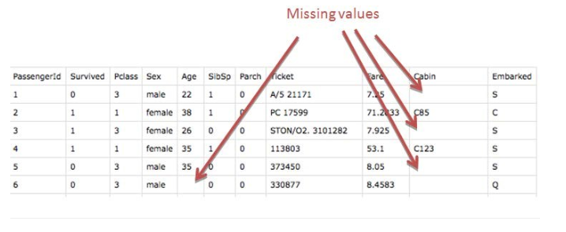
Handling missing values

Slide 20
Handling missing data
Handling missing data is an important aspect of data preprocessing because it can affect the performance and results of machine learning models. There are several strategies for handling missing data, depending on the nature of the dataset and the problem you are solving.

Slide 21
Removing Missing Data
This technique involves deleting rows with missing values, especially if the missing values are not significant or the proportion of missing data is small.
Example: If a dataset has 1000 records, and 5 records are missing a few non-critical data points, those records can be removed to avoid analysis complications.

Slide 22
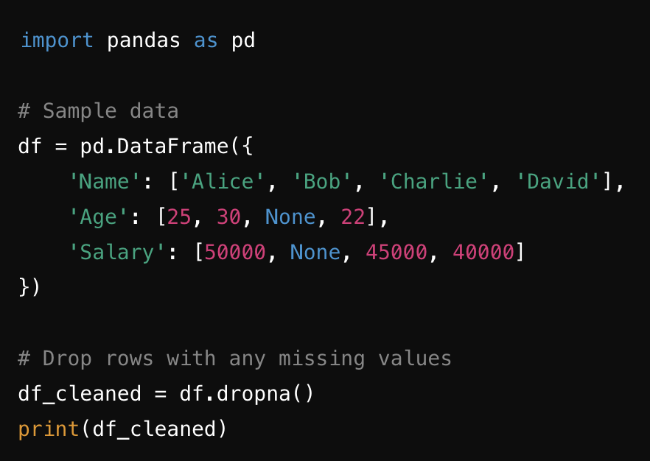
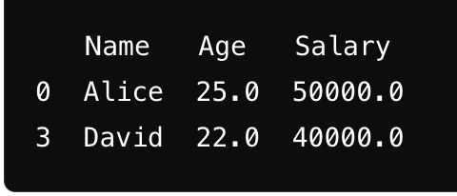
Example
Remove rows or columns that contain missing values.
Output:

Slide 23
Imputation involves replacing missing data with substituted values. Common methods include:
Mean Imputation: Replace missing values with the mean of that column.
Median Imputation: Replace missing values with the median of that column.
Mode Imputation: Replace missing values with the mode of that column.
Imputation (Filling Missing Data)

Slide 24
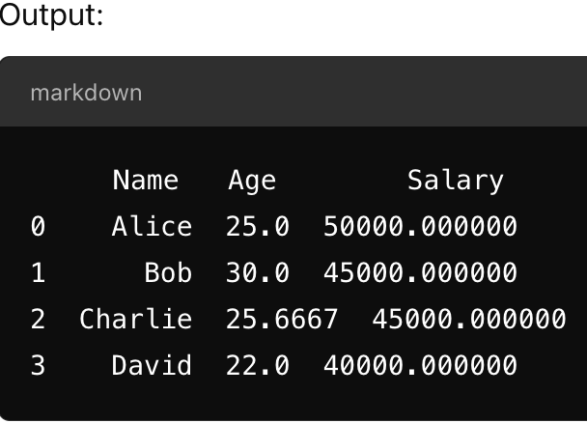
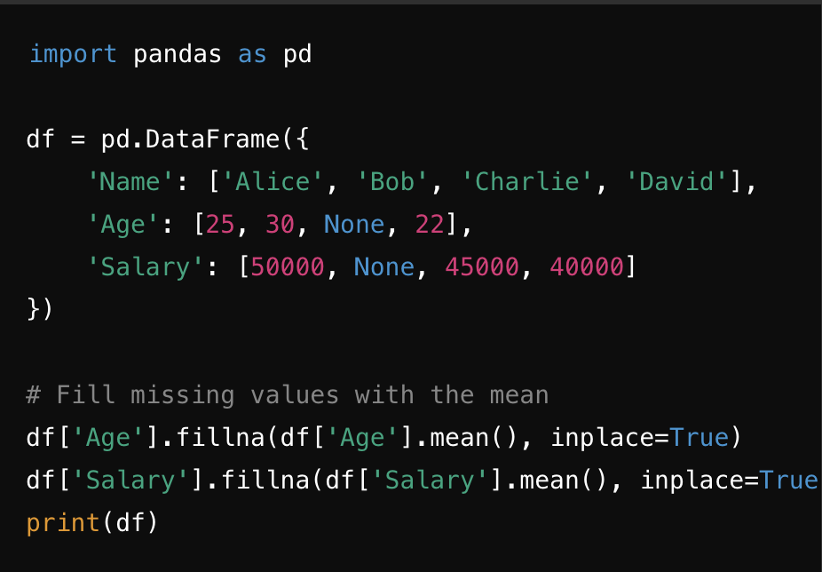
Example of a Filled Mean

Slide 25
Using Algorithms that Support Missing Values
Some machine learning algorithms (e.g., decision trees, Random Forest) can handle missing data naturally.
Use algorithms that handle missing data internally without requiring preprocessing to impute missing values.

Slide 26
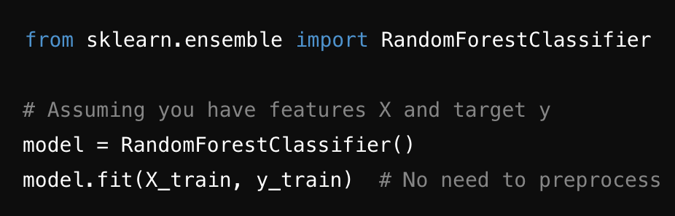
Example: In this case, you wouldn't need to modify the data beforehand; the algorithm will handle missing values internally:

Slide 27
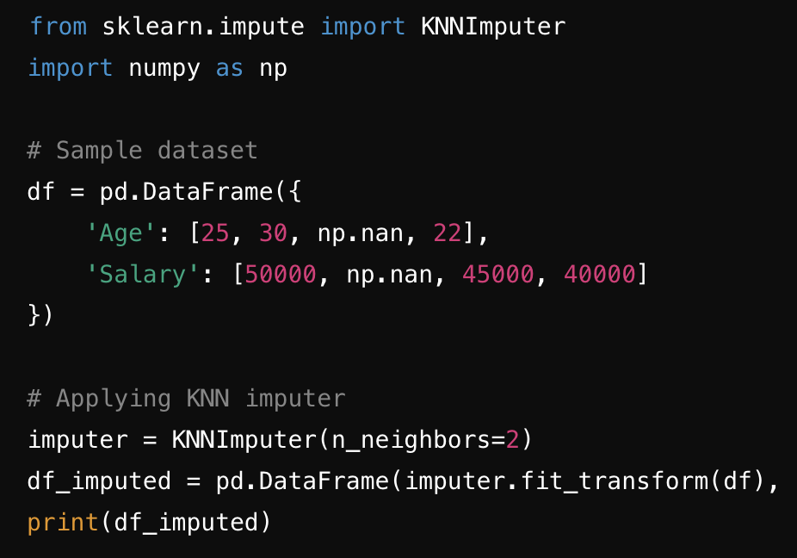
Imputation with More Advanced Methods (KNN, Regression)
When you believe a more sophisticated imputation method is required for better predictions, like using K-nearest neighbors (KNN) or a regression model.

Slide 28
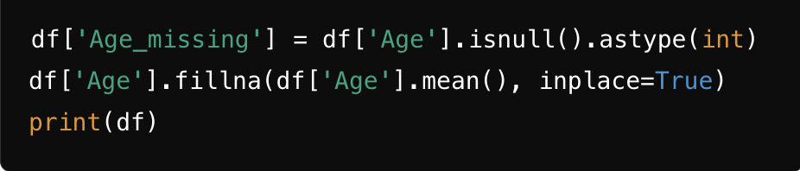
Flag and Fill Missing Data
If you want to keep track of where missing values occurred, you can flag them with a new feature while imputing the missing values.

Slide 29
Handling Duplicate Data
Handling duplicate data is a common task in data management that involves identifying and removing repeated instances of data in a dataset to ensure accuracy and reliability of analyses. This can be crucial in data processing tasks like data cleaning, database management, and statistical analysis.

Slide 30
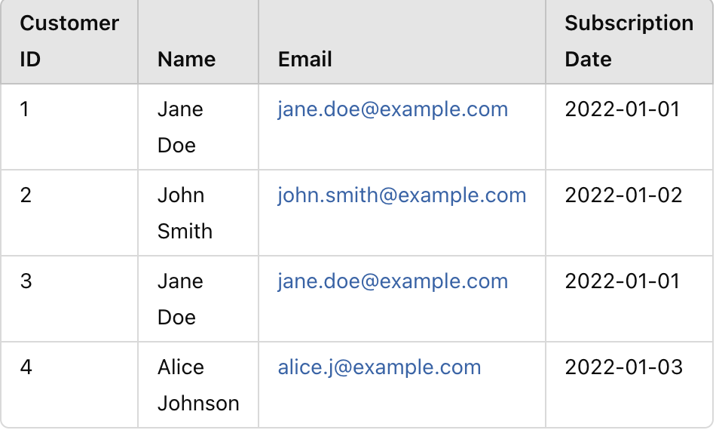
Example
Consider a customer dataset where some entries are duplicated due to data entry errors or system integration issues.

Slide 31
Steps to Handle Duplicate Data
Identify
First need to determine the criteria for a duplicate. In this case, if the Name, Email, and Subscription Date are the same, the record is considered a duplicate.
Review
Before removing duplicates, review them to ensure that they are indeed duplicates and not just similar entries. Sometimes, what appears to be a duplicate could be valid data (e.g., two different customers with the same name and similar email addresses).

Slide 32
Remove
Once confirmed, remove the duplicates. This could mean keeping the first occurrence and removing subsequent ones, or it might involve more complex logic depending on the context (like keeping the entry with the most complete data).
Verify and Document
After removing duplicates, it's important to verify that no essential data was lost and document the process and criteria used for future reference.

Slide 33
Example in Python
Here’s how you might handle duplicates using Python and the pandas library:
import pandas as pd
# Sample data
data = {
'Customer ID': [1, 2, 3, 4],
'Name': ['Jane Doe', 'John Smith', 'Jane Doe', 'Alice Johnson'],
'Email': ['jane.doe@example.com', 'john.smith@example.com', 'jane.doe@example.com', 'alice.j@example.com'],
'Subscription Date': ['2022-01-01', '2022-01-02', '2022-01-01', '2022-01-03']}
df = pd.DataFrame(data)
# Identifying duplicates
duplicates = df.duplicated(subset=['Name', 'Email', 'Subscription Date'], keep=False)
# Display duplicates
print(df[duplicates])
# Removing duplicates
df_cleaned = df.drop_duplicates(subset=['Name', 'Email', 'Subscription Date'], keep='first')
# Display cleaned data
print(df_cleaned)

Slide 34
Handling Outliers
Outliers are data points that are significantly different from the rest of the data. They can arise due to measurement errors, data entry errors, or they could be genuine observations that are simply rare. Handling outliers is crucial because they can distort the results of statistical analyses and lead to misleading conclusions.

Slide 35
Identifying Outliers
Outliers can be identified using various methods:
Statistical Tests: Tests like Grubbs' Test, Dixon's Q test, or Generalized Extreme Studentized Deviate Test can be used to statistically identify outliers.
Visualization: Box plots, scatter plots, and histograms can visually help identify outliers.
Z-score: Points that have a z-score (standard deviations away from the mean) greater than 3 are often considered outliers.
IQR (Interquartile Range) Method: Data points that fall below Q1 - 1.5IQR or above Q3 + 1.5IQR are considered outliers (where Q1 and Q3 are the first and third quartiles, respectively).

Slide 36
Example: Handling Outliers in Dataset
Imagine we have the following dataset representing the ages of participants in a study:
21,22,23,22,100,23,22,21,2021, 22, 23, 22, 100, 23, 22, 21, 2021,22,23,22,100,23,22,21,20
Here, 100 is an apparent outlier as it is significantly different from the other ages.
Using IQR to Handle Outliers
Calculate Q1 and Q3:
Sorted data: 20,21,21,22,22,22,23,23,10020, 21, 21, 22, 22, 22, 23, 23, 10020,21,21,22,22,22,23,23,100
Q1 (25th percentile) = 21
Q3 (75th percentile) = 23
Calculate IQR:
IQR = Q3 - Q1 = 23 - 21 = 2
Determine outlier thresholds:
Lower bound = Q1 - 1.5*IQR = 21 - 3 = 18
Upper bound = Q3 + 1.5*IQR = 23 + 3 = 26
Identify outliers:
100 is outside the upper bound of 26 and is identified as an outlier.

Slide 37
Handling Methods
Remove: Simply delete the outlier from the dataset.
New dataset: 21,22,23,22,23,22,21,2021, 22, 23, 22, 23, 22, 21, 2021,22,23,22,23,22,21,20
Cap: Replace outliers with the nearest value within the acceptable range.
Capped dataset: 21,22,23,22,26,23,22,21,2021, 22, 23, 22, 26, 23, 22, 21, 2021,22,23,22,26,23,22,21,20
Impute: Replace the outlier with a more reasonable value, such as the median or mean of the remaining data.
Imputed dataset: 21,22,23,22,22,23,22,21,2021, 22, 23, 22, 22, 23, 22, 21, 2021,22,23,22,22,23,22,21,20
Transform: Apply a transformation that reduces the impact of outliers, such as a log transformation.
Handling outliers appropriately is context-dependent and should consider the nature of the data and the purpose of the analysis.

Slide 38
Data Normalization
Data normalization is a process used to adjust the values in a dataset to a common scale, without distorting differences in the ranges of values or losing information. Normalization is often required in data preprocessing, especially in machine learning and data mining, to ensure that the numerical data within a dataset has more uniform values. This is important because many algorithms assume that all features are on comparable scales and might behave poorly if the feature scales are disparate.

Slide 39
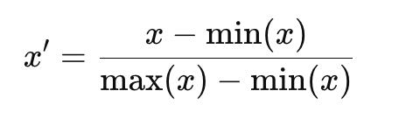
Min-Max Scaling:
This method rescales the data to a fixed range, usually 0 to 1, or -1 to 1. The formula is:

Slide 40
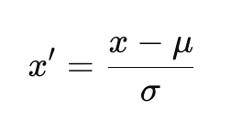
Z-score Normalization (Standardization):
This method scales the data so that it has a mean of 0 and a standard deviation of 1. The formula is:

Slide 41
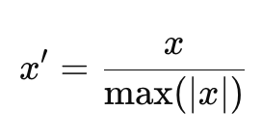
Max Abs Scaling:
This method scales each feature by its maximum absolute value to transform the data within the range [-1, 1]. It is defined as:

Slide 42
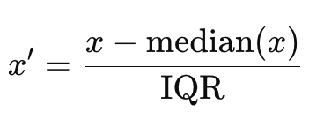
Robust Scaling:
This method uses the median and the interquartile range for scaling, making it robust to outliers. It is computed as:

Slide 43
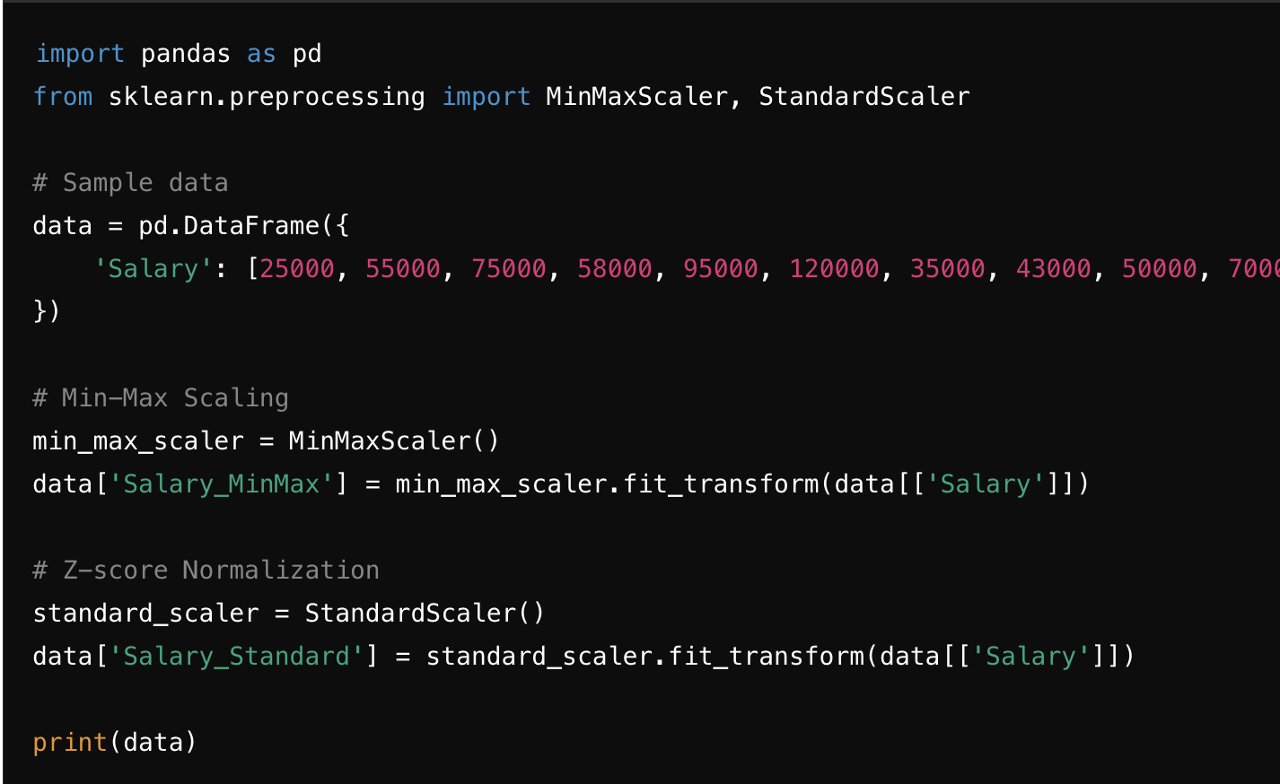
Data Normalization Using Python.
Let's assume we have a dataset with salary figures that vary significantly and we want to apply Min-Max scaling and Z-score normalization
This code creates a DataFrame displaying original salary values alongside their normalized forms using two methods:
MinMaxScaler adjusts salaries to a 0-1 scale.
StandardScaler standardizes salaries to have a mean of zero and a standard deviation of one.
Applying these transformations helps enhance the performance of algorithms sensitive to data scale, such as many machine learning models.

Slide 44
Handling Inconsistent Data
Handling inconsistent data is a critical part of data preprocessing, especially when merging data from different sources or cleaning up datasets for analysis. Inconsistent data can manifest in various forms, such as discrepancies in labels, formats, or multiple entries that should be identical but are not due to typographical errors, different naming conventions, or outdated information.

Slide 45
Examples of Inconsistent Data:
Different conventions or formats: For instance, dates might be recorded in different formats (e.g., DD/MM/YYYY vs. MM/DD/YYYY).
Typos and spelling errors: For example, "New York" might be entered as "New Yrok".
Different naming conventions: "USA" vs. "United States".
Duplications: The same entity might be listed multiple times with slight variations, such as "Google LLC" and "Google Inc."

Slide 46
Steps to Handle Inconsistent Data:
Standardization: Apply a uniform format across all data entries for a specific attribute.
Data Cleaning: Correct typos and align different naming conventions using mapping, especially when merging datasets.
Deduplication: Identify and merge duplicate entries.

Slide 47
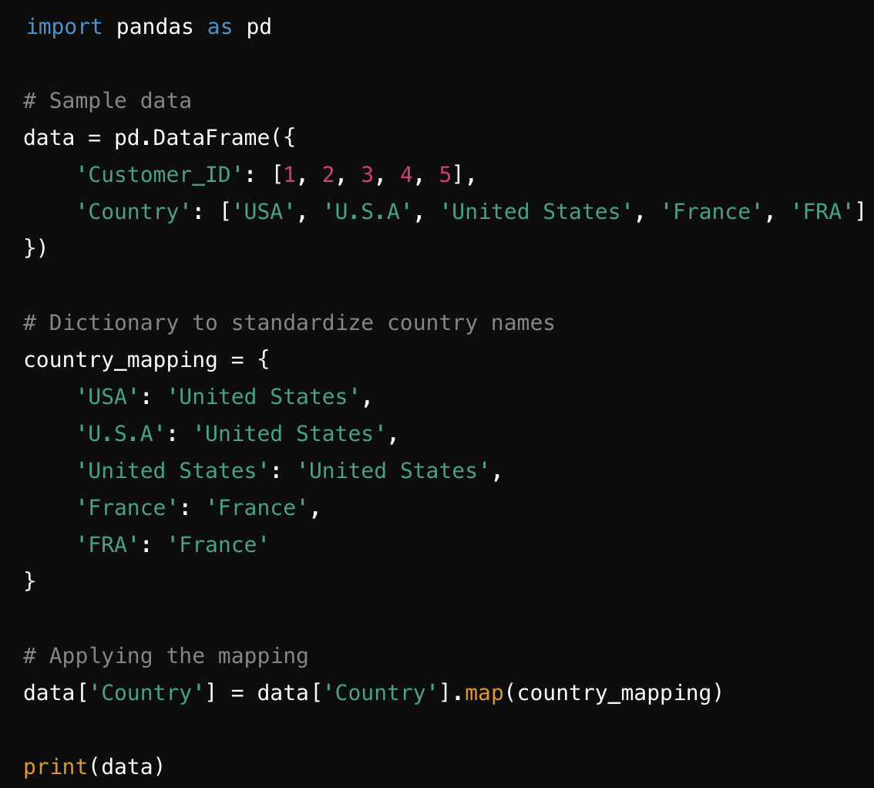
Python Example: Handling Inconsistent Data
Assume we have a dataset of customer information where the country names are entered inconsistently. We need to standardize the country names.

Slide 48
Explanation:
Dictionary country_mapping: Maps various forms of country names to a standardized form.
Mapping function: Applies this dictionary to the 'Country' column to standardize the names.
This approach ensures that data from different sources can be accurately compared or analyzed, reducing errors and improving the reliability of the dataset.

Slide 49
Validating Data Accuracy
Validating data accuracy is a crucial step in ensuring that data is reliable and suitable for analysis or decision-making. It involves verifying that the data correctly represents the real-world values it is supposed to model. This process helps identify and correct errors that could lead to incorrect conclusions or faulty predictions.

Slide 50
Examples of Data Inaccuracies:
Typographical Errors: Incorrect data entries made during data collection or entry.
Outdated Information: Data that is no longer relevant or correct due to changes over time.
Incorrect Values: Data entries that do not conform to expected ranges or formats.
Inconsistencies Across Sources: Conflicting data entries from different data sources.

Slide 51
Steps for Validating Data Accuracy:
Range Checking: Ensure that data falls within the predefined bounds or logical limits.
Cross-Validation with External Sources: Compare data entries with trusted external sources to confirm accuracy.
Consistency Checks: Ensure that data across different records or fields follows logical rules or patterns.
Completeness Checks: Verify that all necessary data fields are filled and sensible.

Slide 52
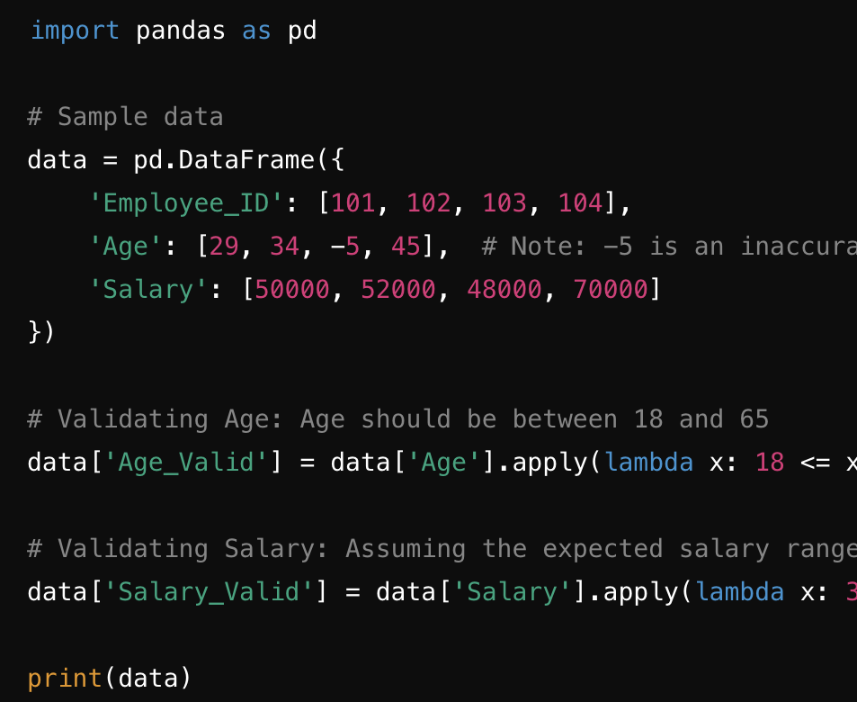
Example:
Suppose we have a dataset representing employee records with their ages and salaries. We need to validate that the ages and salaries are within reasonable and expected ranges.

Slide 53
Output Explanation:
Age and Salary Columns: Includes validations where each entry is checked to be within a reasonable range.
Age_Valid and Salary_Valid: Boolean columns added to the dataset that show whether each entry passes the validation criteria.
This process of validation ensures that data used in further analyses is accurate, improving the reliability of any insights drawn from the data. By identifying and correcting inaccuracies, you safeguard the integrity of the data and maintain high standards for data quality.

Slide 54
Data Transformation
Data transformation is a critical step in preparing your data for modeling, especially when dealing with categorical data. Here, I'll explain two common methods of encoding categorical data—Label Encoding and One-Hot Encoding—and then provide an example of feature engineering to create new features from existing data.

Slide 55
Encoding Categorical Data
1. Label Encoding converts each category in a column into a unique integer based on alphabetical ordering. It's particularly useful when the categorical variable is ordinal (i.e., the categories have a meaningful order). However, when using this method with nominal data (i.e., no intrinsic ordering), some algorithms may misinterpret the numerical values as having some form of hierarchy or order, which can lead to poor performance.

Slide 56
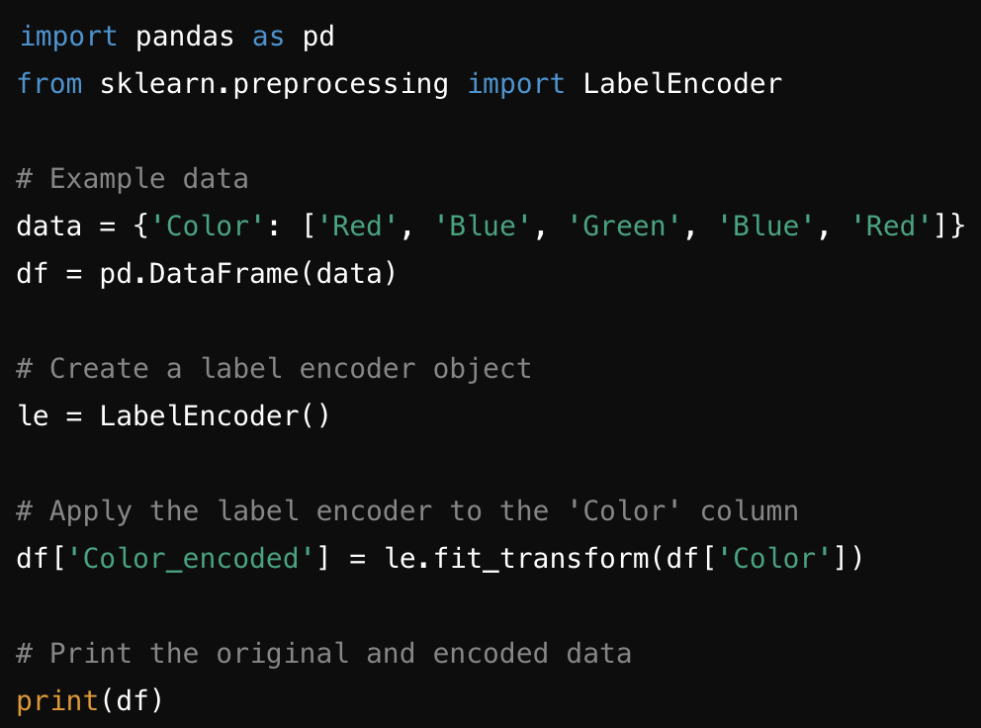
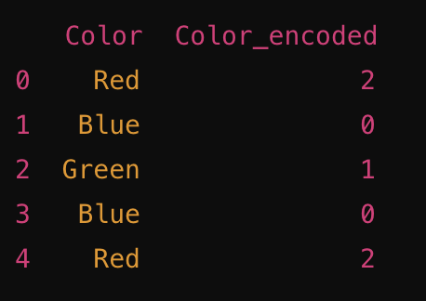
Python Code Example:

Slide 57
2. One-Hot Encoding
One-Hot Encoding creates a new column for each unique value in the original column. Each observation has a 1 in the column of the value it has and 0 in all other new columns. This method is ideal for nominal categorical data where no ordinal relationship exists.

Slide 58
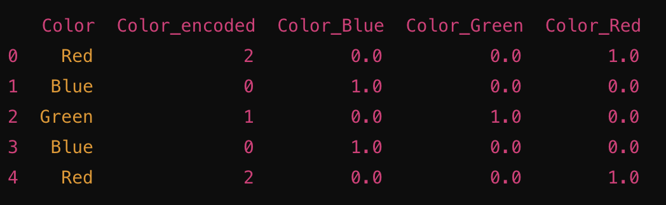
Python Code Example:
from sklearn.preprocessing import OneHotEncoder
# Initialize a OneHotEncoder with sparse=False to output a dense array
onehot = OneHotEncoder(sparse=False)
# Fit and transform the 'Color' column one_hot_encoded_data = onehot.fit_transform(df[['Color’]])
# Create a DataFrame with the encoded data and appropriate column names
df_one_hot = pd.DataFrame(one_hot_encoded_data, columns=onehot.get_feature_names(['Color']))
# Concatenate the original data and the one-hot encoded data
print(pd.concat([df, df_one_hot], axis=1))

Slide 59
3. Feature Engineering
Feature engineering involves creating new features or modifying existing features which might increase the predictive power of the learning algorithm.
Interaction Feature
Suppose you have data on a house's number of rooms and its total square footage. An interaction feature could be the average size per room, which might provide more insight than the two separate features.

Slide 60
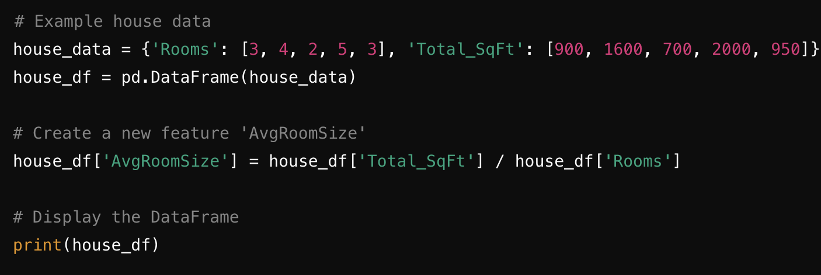
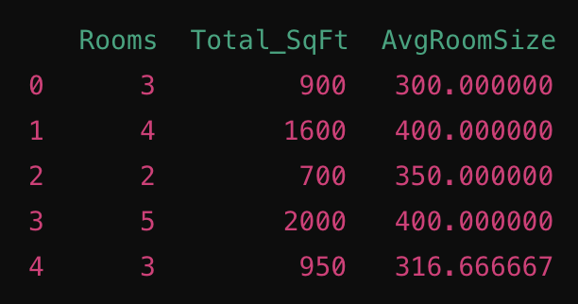
These examples illustrate how data transformation and feature engineering can help prepare your data for better analysis and modeling, enhancing the effectiveness of predictive models.

Slide 61
Tools and Techniques for Data Cleaning
Software Tools
Several software tools are available to aid in data cleaning. Some of the most popular ones include:
Microsoft Excel: Offers basic data cleaning functions such as removing duplicates, handling missing values, and standardizing formats.
OpenRefine: An open-source tool designed specifically for data cleaning and transformation.
Python Libraries: Libraries like Pandas and NumPy provide powerful functions for data cleaning and manipulation.
R: The R programming language offers robust packages for data cleaning, such as dplyr and tidyr.

Slide 62
Techniques
Effective data cleaning also involves various techniques, such as:
Regular Expressions: Useful for pattern matching and text manipulation.
Data Profiling: Involves examining data to understand its structure, content, and quality.
Data Auditing: Systematically checking data for errors and inconsistencies.

